Slide 1
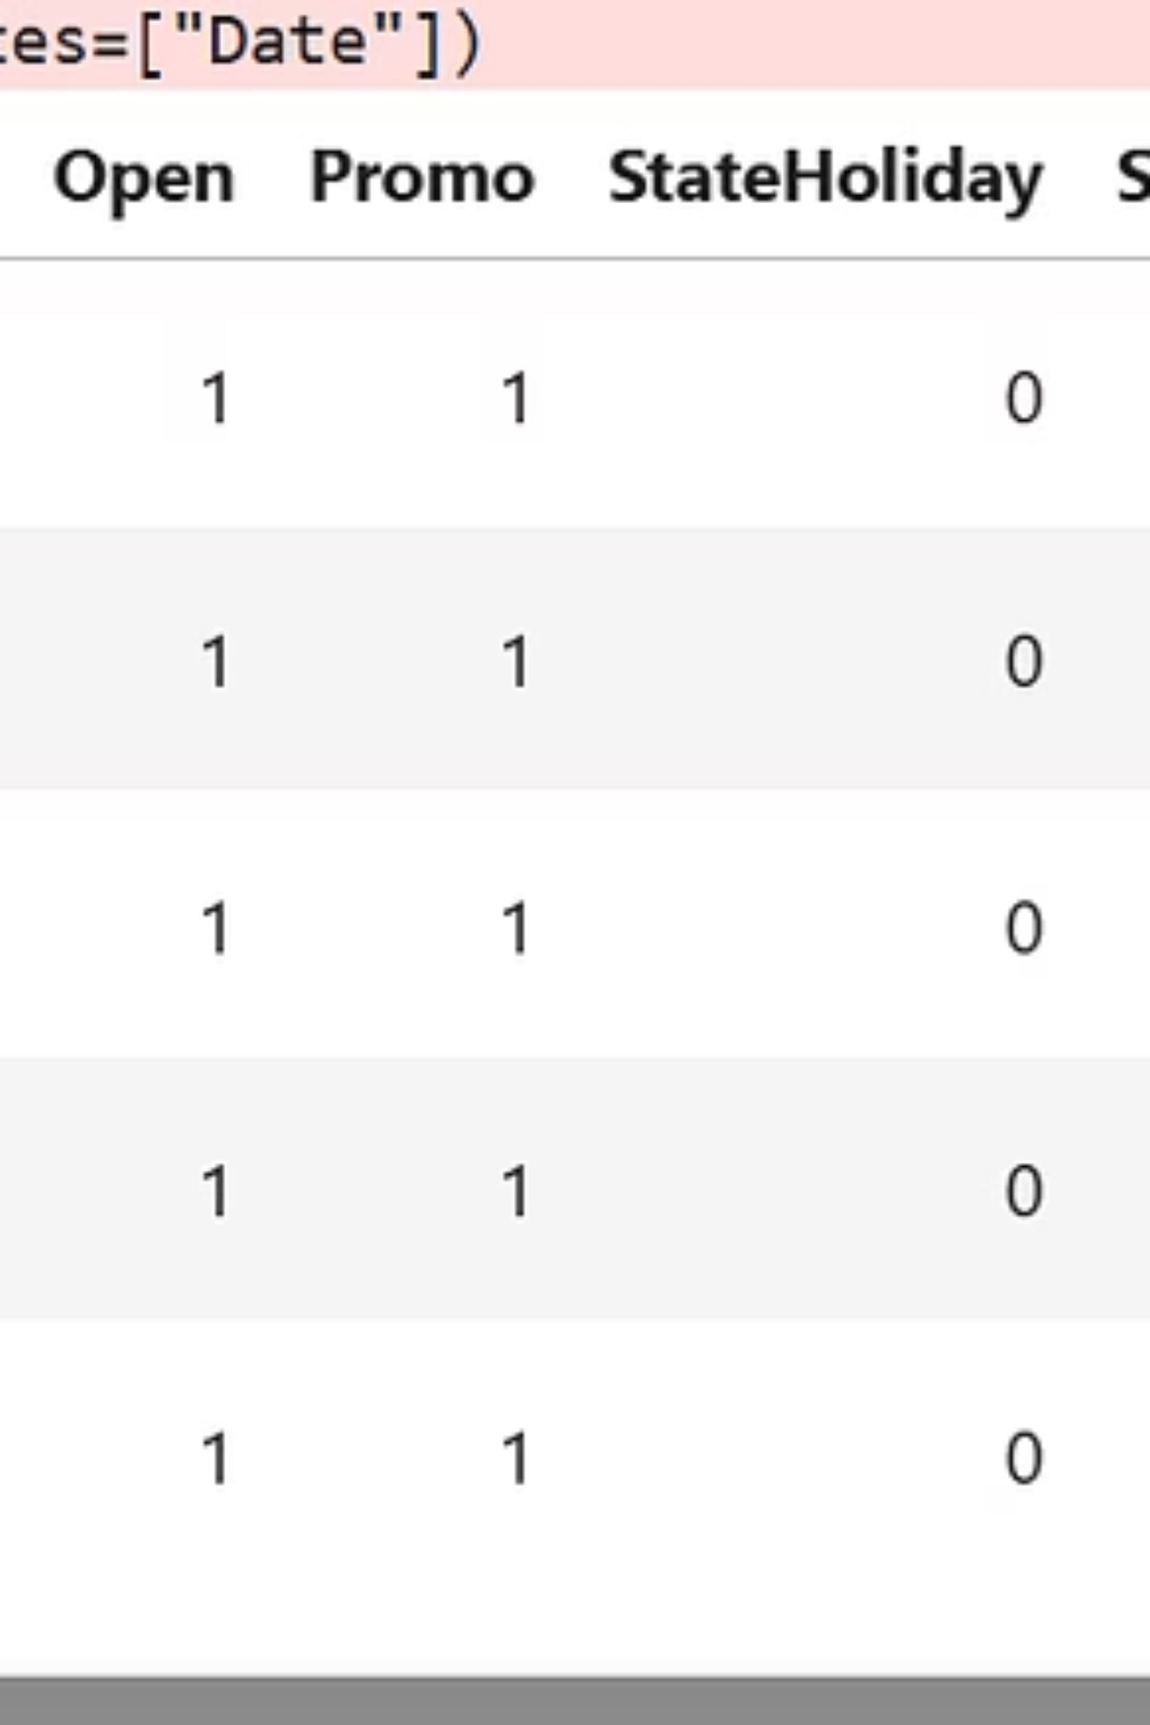
Sales Forecasting Across Multiple Retail Stores
Presented by: Shivangi Chaudhary
Nexthikes IT Solutions

Slide 2
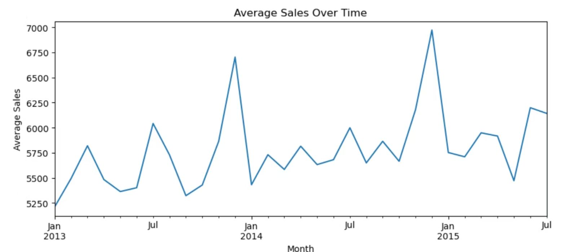
Project Objective
Our Mission
Analyze comprehensive store sales patterns and develop a robust prediction model that accurately forecasts future sales performance using historical retail data.
This data-driven approach enables strategic decision-making, optimized inventory management, and improved resource allocation across multiple store locations.

Slide 3
Project Workflow
01
02
Data Loading & Cleaning
Exploratory Data Analysis
Importing datasets and handling missing values
Uncovering patterns and trends in sales data
03
04
Feature Engineering
Model Building
Creating meaningful variables for prediction
Training algorithms on historical patterns
05
06
Predictions on Test Data
Final Insights
Validating model performance
Extracting actionable business recommendations
Tools Used: Python, Pandas, NumPy, Matplotlib, Scikit-learn

Slide 4
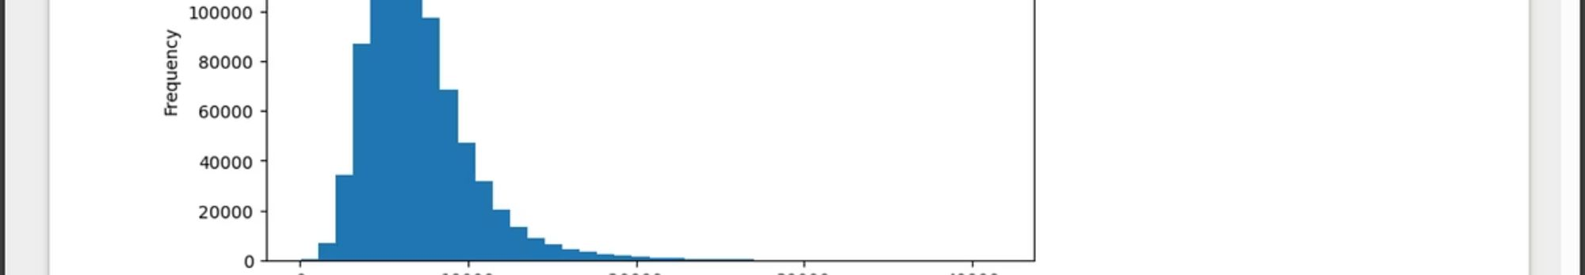
EDA Insights: Understanding Sales Patterns
Sales Distribution Analysis
Monthly Sales Trends
Store Type Performance
Sales data exhibits significant right skew, with most days showing moderate performance while a small number of days achieve exceptionally high sales volumes.
Average monthly sales reveal seasonal patterns and cyclical trends throughout the year.
Comparative analysis shows certain store types consistently outperform others in sales generation.
Understanding these fluctuations enables better inventory planning and staffing decisions aligned with demand.
These insights inform strategic expansion decisions and store format optimization.
This pattern suggests opportunity for targeted promotional strategies during peak periods.

Slide 5
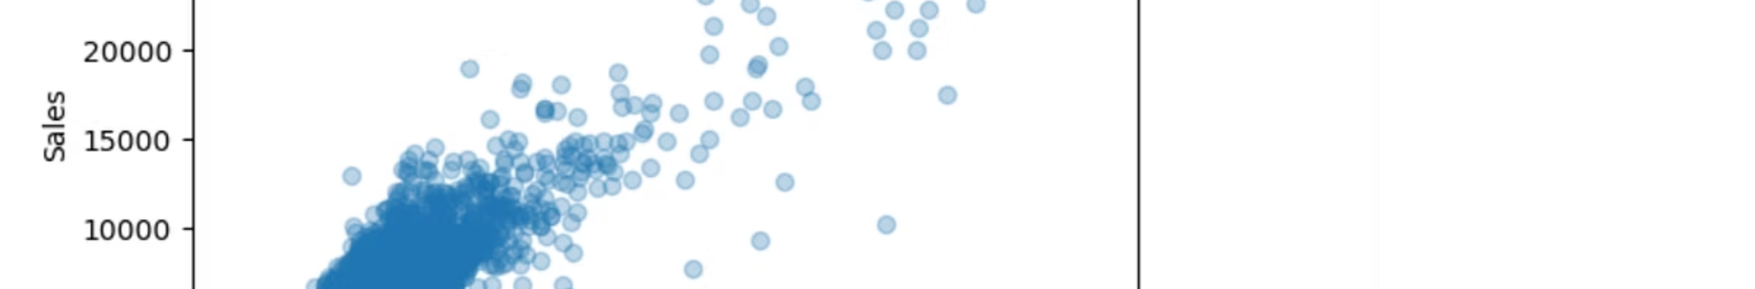
Correlation Analysis
Sales vs Customers
Key Observations
Strong positive correlation
Sales and Customers demonstrate the strongest positive correlation, confirming foot traffic drives revenue
More customers → higher sales
Promo Effect
Promotional activities show positive relationship with sales performance
Promo days significantly increase sales
Most numerical features exhibit weak correlation, helping identify truly impactful variables
Heatmap analysis streamlines feature selection for optimal model performance

Slide 6
Feature Engineering & Model Selection
Feature Engineering
Decision Tree Regressor
Temporal Features
Selected for its balance of performance and interpretability in retail forecasting applications.
Extracted Year, Month, Day, and WeekOfYear to capture seasonality
Behavioral Indicators
Easy to Understand
Created IsWeekend flag to distinguish shopping patterns
Clear decision paths stakeholders can interpret
Data Enrichment
Handles Non-Linearity
Merged store-specific details and filled missing values strategically
Captures complex retail patterns effectively
Minimal Preprocessing
Reduces data preparation complexity
Fast Training
Enables rapid iteration and deployment

Slide 7
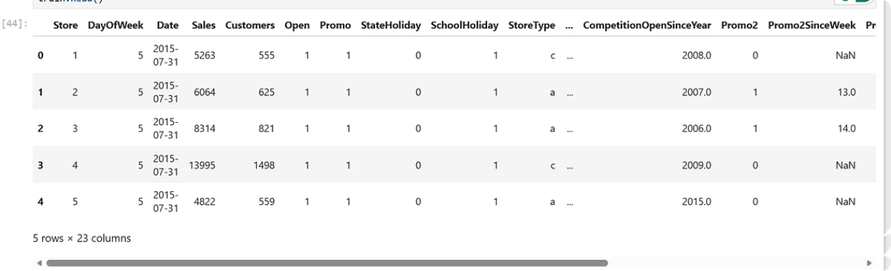




Predictions & Results
Training Process
Selected key features: Store, DayOfWeek, Promo, Month, Year, and Customers for optimal prediction accuracy
Model Validation
Trained exclusively on open-store sales data with 20% validation split to ensure robust performance
Final Outcome
Generated comprehensive predictions for all test scenarios, exported to simple_predictions.csv
Model Performance
Business Impact
Mean Absolute Error (MAE) demonstrates strong predictive accuracy, validating the model's capability to forecast daily store sales with reliable precision.
This working model empowers retail decision-makers with data-driven sales forecasts, enabling proactive inventory management and strategic planning across all store locations.

Slide 8
Reference-
Streamlit Docs
Decision Tree (CART) - Machine Learning Fun and Easy
https://www.youtube.com/watch?v=bK7I79BVTG0
Plot types — Matplotlib 3.10.7 documentation
train_test_split

Slide 9

Thank You
Contact Information
Questions?
Shivangi Chaudhary
We welcome your feedback and are ready to discuss implementation strategies for your retail forecasting needs.
Nexthikes IT Solutions

